Slide 1
Prescription Pain Pills in California
David Jaimes
Steven Quitugua

Slide 2
Motivation
Analyze current prescription drug epidemic
Data after 2015 not released to public because of ongoing investigations
Increased lawsuits towards big Pharma companies
Understanding of how the opioid epidemic affects us locally
Understand the relationship between income and death rates
150 people die a day from opioid overdose
Cities paying 200 million a year to keep up with the increased death rates

Slide 3
Hypotheses
If income and number of pills are related, then higher incomes will have a greater number of pills.
If death rates and race are related, then black communities will have higher death rates than white communities.
If pill rates and number of deaths are related, then higher than average death rates will have higher than average number of pills.
If pill rates and death rates are related, then higher than average death rates will have higher than average number of pills.

Slide 4
Data Collection
Population and Income
State of California Department of Finance 2010
Death Rates
California Department of Public Health 2010
California Opioid Overdose Surveillance Dashboard
Number of Pills
Drug Enforcement Agency
Automation of Reports and Consolidated Orders and System (ARCOS)
Washington Post
Drilling Into the DEA’s pain pill database

Slide 5
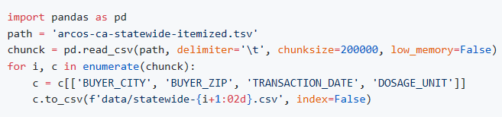
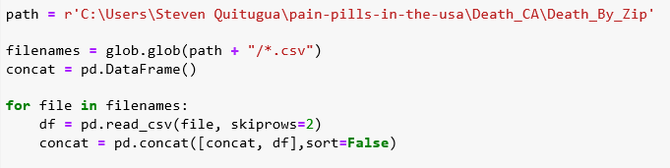
Clean up
U.S. data had 90 GB .csv file, whereas California’s data was 6 GB
“chunksize” parameter to read 200,000 rows at a time as opposed to all at once
Utilizing “glob” to combine multiple csv files into one variable

Slide 6
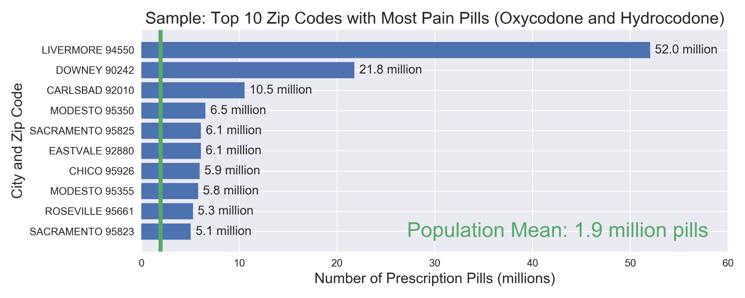
Top Zip Codes with Most Pills

Slide 7
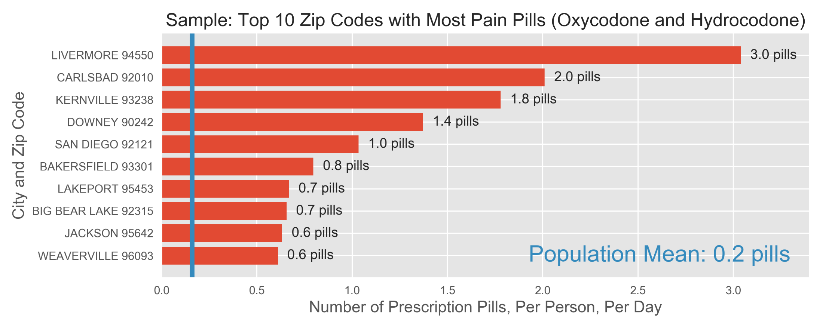
Top Cities with Most Pills Per Person

Slide 8
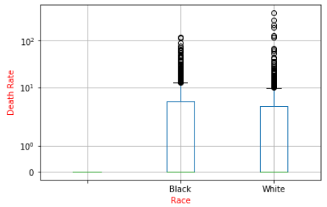
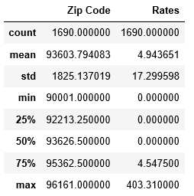
Race Versus Death Rates
1st quartile and minimum was not displayed because median was zero
4th quartile to maximum for the white community had a 98.87% increase
P Value = .95877 which is not significant and resulted in a Null Hypothesis

Slide 9
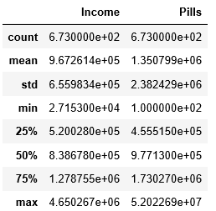
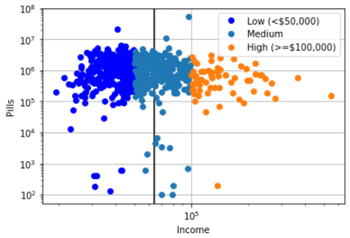
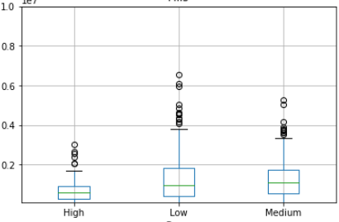
Income Versus Pills
Each color represents an income class
The black line indicates the mean income
The box plot displays amount of pills by income class
T-test resulted in: 0.07999 which is not significant
and disproves the hypothesis

Slide 10
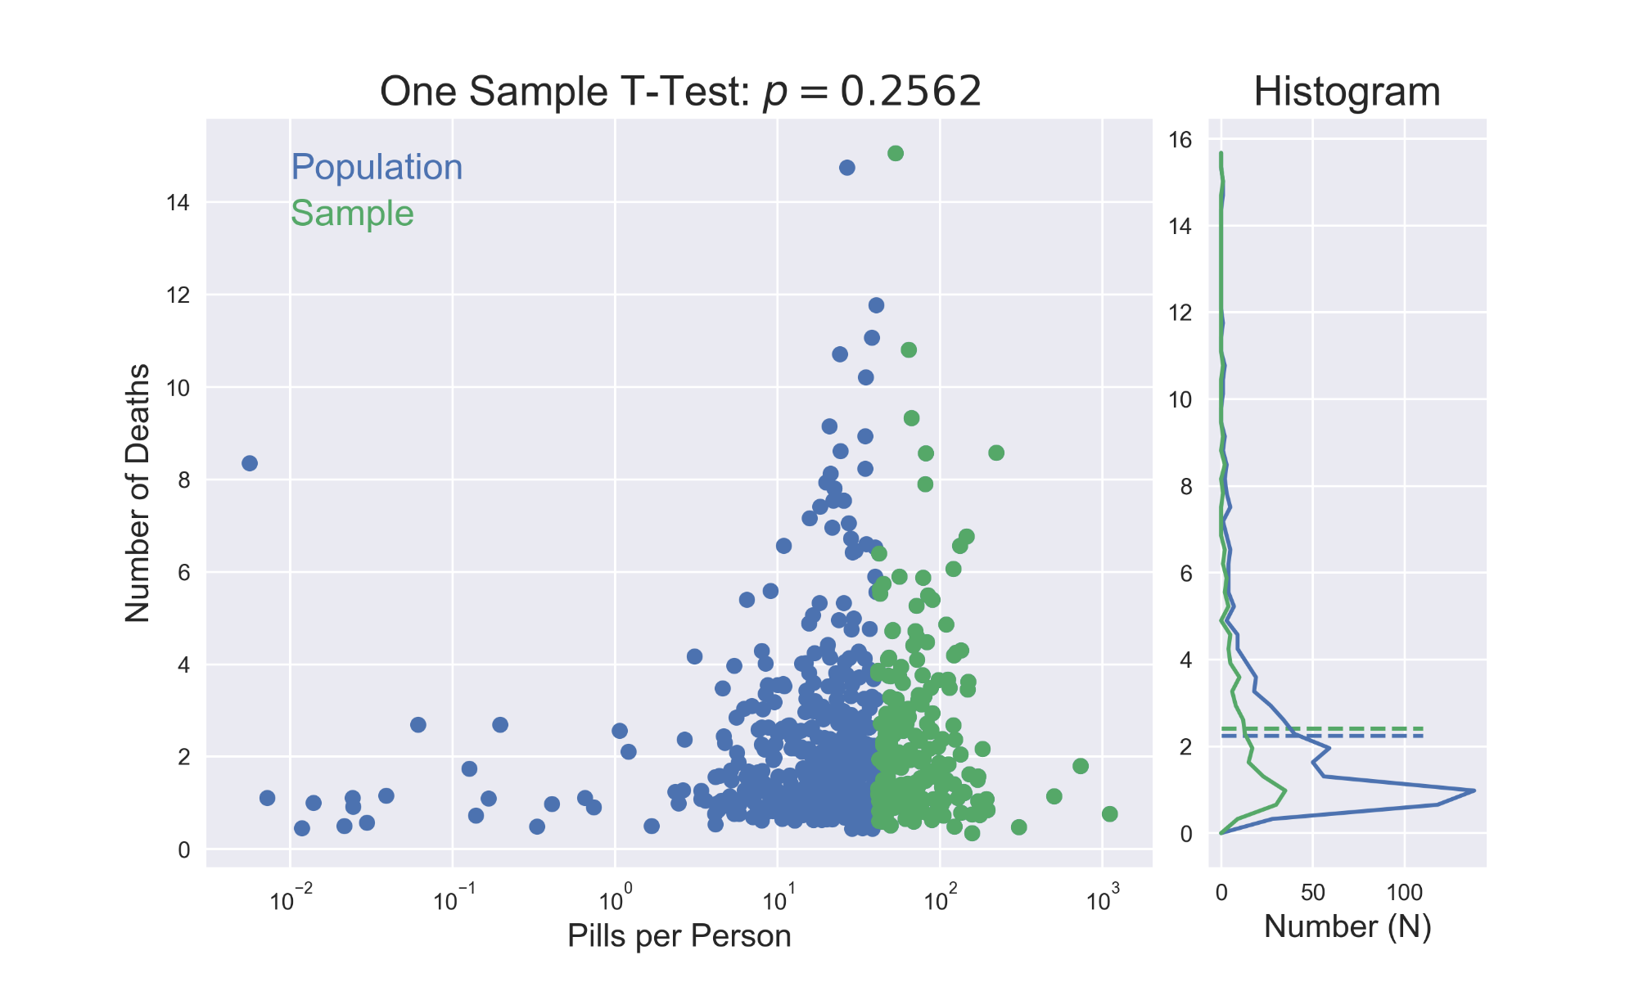
Number of Deaths vs Pill Rates

Slide 11
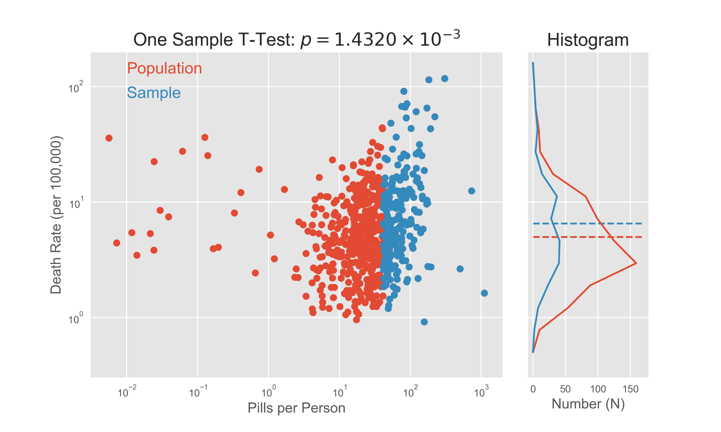
Death Rates vs Pill Rates

Slide 12
Conclusions and Summary
Race versus death rates resulted in a null hypothesis, which means they are not dependent on each other.
Income versus number of pills are also not dependent on each other. No significance to accept our hypothesis.
Pill Rates and Number of Deaths have similar distributions and higher than average pills per person does not yield greater number of overdoses from prescription pills.
Higher than average Pill Rates seems to be a good predictor of higher than average Death Rates.

